Slide 1

Data Science for medicine applications

Slide 2

Supervised By:
Dr. Ahmed Ezz
Eng. Sara Gamal

Slide 3


Prepared by:
1-Alaa Ibrahim Amin 20-01771
2-Amira Mohamed Ahmed 20-01740
3-Alaa Abdelhady Zaky 20-01773
4-Abdelmeseeh Talaat Fekry 20-01943
5-Kirolos Elkomos Rofieal 20-00741
6-Aya Ali El Sayed 20-01775
7-Haidy Mohamed Abu El-safa 20-01669

Slide 4
Outlines
Introduction
Background and motivation
Problem Solutions
Project overview
Conclusion and Future considerations
Tools Prototype
Reference

Slide 5
Introduction
01

Slide 6

Breast Cancer Recurrence
Breast cancer is one of the most prevalent and deadly forms of cancer, affecting millions of women worldwide. Early detection and accurate prediction of cancer recurrence are critical for improving treatment outcomes and patient prognosis. This project aims to leverage data mining techniques to develop a robust system for predicting the likelihood of breast cancer recurrence, empowering healthcare professionals to make more informed decisions and enhance patient care.

Slide 7
Background and Motivation
02

Slide 8

Breast Cancer
-The second leading cause of death among women is breast cancer , as it comes directly after lung cancer.
-Breast cancer considered the most invasive cancer in women, with more than million cases and nearly 600,000 deaths occurring worldwide annually.
-Breast cancer comes in the top of cancer list in Egypt by 40 cases per 100,000 of the population.
-But there are a great range of deaths in Egypt.
-Recurrent breast cancer is breast cancer that comes back after initial treatment. undetected cancer cells multiply, becoming recurrent breast cancer.
-

Slide 9
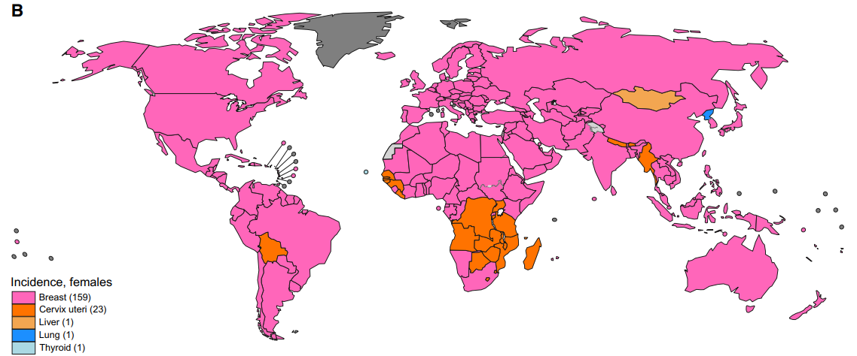
Breast Cancer
According to World Health Organization 2022 , Breast cancer is
the most common malignancy diagnosed in women worldwide.

Slide 10
Problem Solution
03

Slide 11
Problem Solution
Breast cancer recurrence is a significant concern, as it can have devastating consequences for patients and their families. Despite advancements in treatment methods, a significant number of patients experience cancer recurrence, leading to additional rounds of therapy, emotional distress, and increased healthcare costs. Developing an accurate and reliable predictive model for recurrence risk can help clinicians tailor treatment plans, implement targeted interventions, and improve overall patient outcomes.
The motivation behind this project is to leverage the power of data mining and machine learning to create a decision support system that can assist healthcare professionals in making more informed decisions about breast cancer treatment and follow-up care. By identifying the key factors that contribute to recurrence risk, we aim to empower patients and healthcare providers to take proactive steps in managing this challenging disease.

Slide 12





Problem Solutions
Awareness
Database
Recurrent Detection
Statistics

Slide 13
Project Overview
04

Slide 14
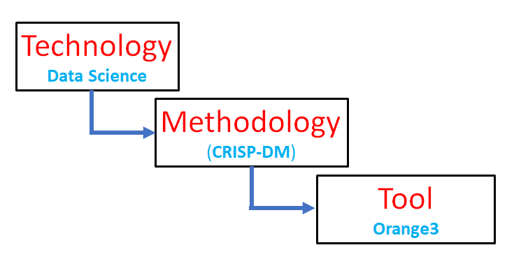
Project Development

Slide 15
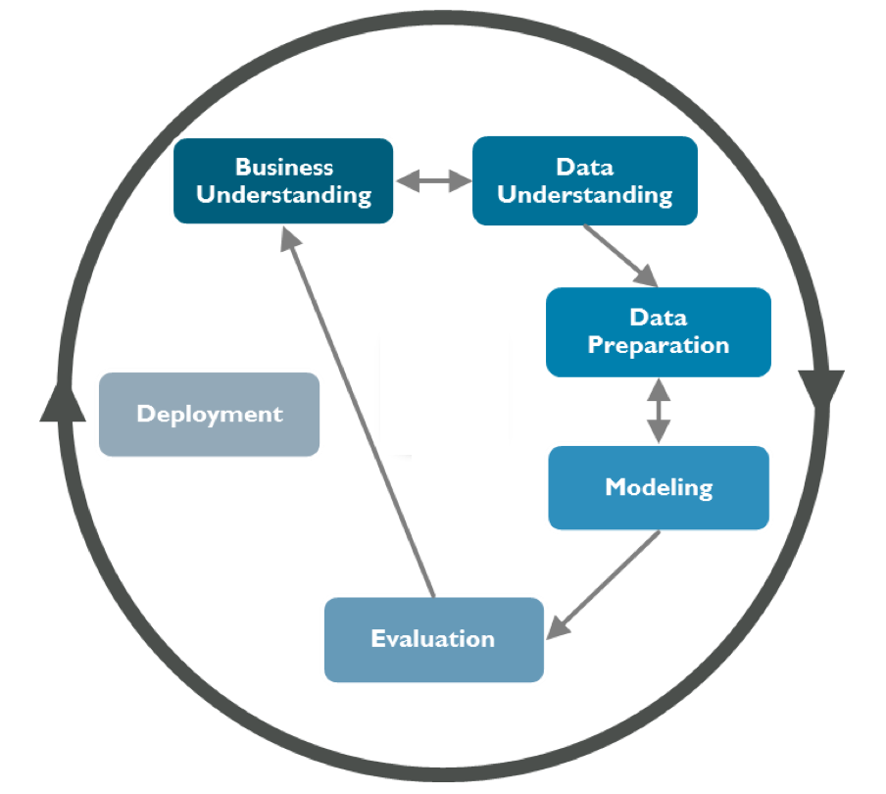
Business Understanding
CRISP-DM
Breast cancer is the most common cancer affecting females worldwide. Breast cancer recurrence or nonrecurrence prediction is challenging and a complex research task. Existing approaches engage statistical methods or supervised machine learning to assess/predict the recurrence or non-recurrence of breast cancer.

Slide 16
Data Understanding:
Collect and explore relevant breast cancer data. Understand the characteristics of the dataset

Slide 17
Data Field | Description: | Data Values:
age: | Represents the age of the patient. (numeric) ,This is a nominal attribute that can be used to compare the incidence of breast cancer among different age groups. | Categorized into age ranges, such as "20-29, 30-39, 40-49, 50-59, 60-69, 70-79”
menopause: | Indicates the menopausal status of the patient. , This is also a nominal attribute that can be used to study the effect of menopause on breast cancer risk. | Includes either premeno (premenopausal), ge40 (greater than or equal to 40 years old at menopause), or lt40 (less than 40 years old at menopause).
tumor-size: | Describes the size of the tumor. This is an ordinal attribute that can be used to measure the severity of the tumor and its potential to spread. | tumor size range such as 0-4, 5-9, 10-14, 15-19, 20-24, 25-29, 30-34, 35-39, 40-44, 45-49, 50-54
inv-nodes: | This column indicates the number of axillary lymph nodes that are involved by the tumor | Categorized into age ranges, such as 0-2, 3-5, 6-8, 9-11, 12-14, 15-17, 24-26

Slide 18
Data Field | Description: | Data Values:
node-caps: | Indicates whether the tumor has affected the surrounding lymph nodes' capsules.This is a binary attribute that can be used to determine the invasiveness of the tumor and its likelihood of metastasis. | Binary, "yes" or "no."
deg-malig: | Denotes the degree of malignancy or aggressiveness of the tumor. | either 3 (high), 1 (low), or 2 (medium)
breast: | This column indicates which breast is affected. | either right or left.
breast-quad: | This column indicates which quadrant of the breast is affected by the tumor | either left_up (upper left), left_low (lower left), central (central), right_up (upper right), or right_low (lower right).
irradiat: | This column indicates whether the patient received radiation therapy as part of the treatment | either yes or no
Class: | This column indicates the recurrence status of the patient | either recurrence-events (the patient had a recurrence of breast cancer) or no-recurrence-events (the patient did not have a recurrence of breast cancer).

Slide 19
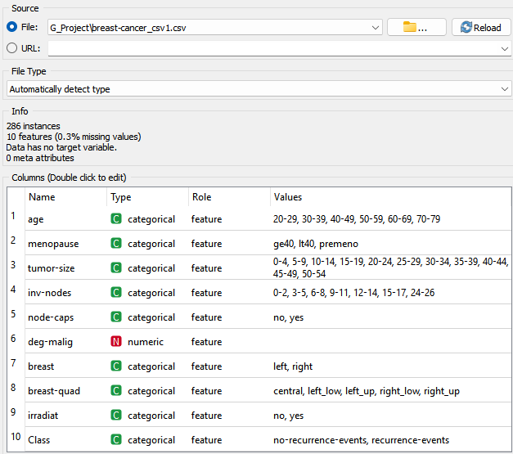
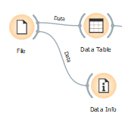
Load Data:
The File widget reads the input data file and sends the dataset to its output channel.
the widget is used to read the data that is sent to both the Data Table and the Data Info widget

Slide 20
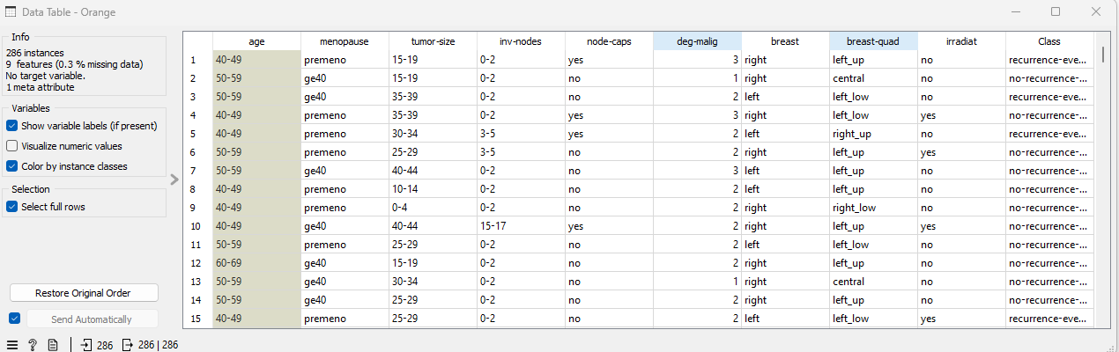
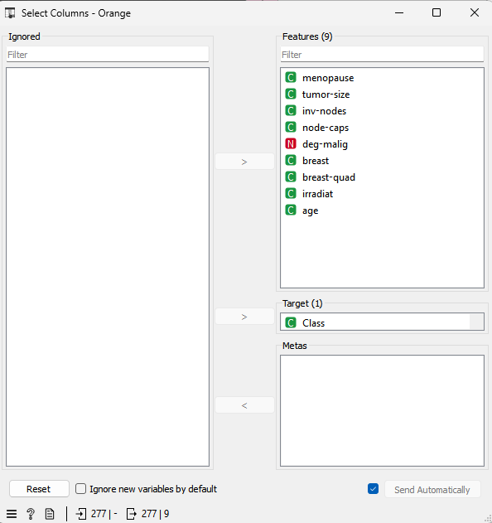
Data Exploration:
Use the "Data Table" widget to explore the dataset. Check for the presence of missing values, examine the distribution of categorical and numerical features, and ensure the data types are correctly identified.
Select column:
The Select Columns widget is used to manually compose your data domain. The user can decide which attributes will be used and how.

Slide 21
Data Preparation:
Clean and preprocess the breast cancer data.
Handle missing values and perform transformations as needed. +
Ensure the dataset is ready for analysis.

Slide 22
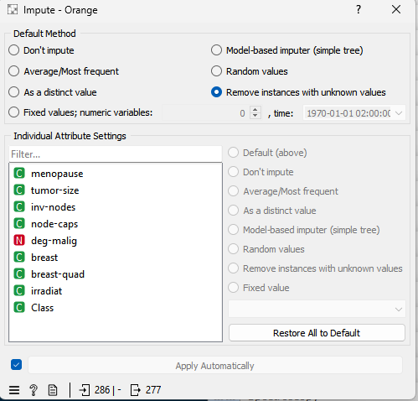
Impute Missing Values
The Impute widget is used to handle missing values in your dataset. It provides methods for imputing missing values, such as mean, median, or most frequent.

Slide 23
Descriptive Analytics (What Happened):
A statistical interpretation used to analyze data to identify patterns and relationships.
Descriptive analytics seeks to describe the phenomenon or outcome.
The purpose of descriptive analytics is to turn data into insights. It is used to understand what happened in the past

Slide 24
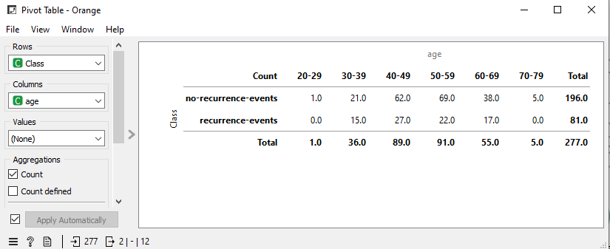
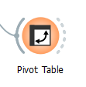
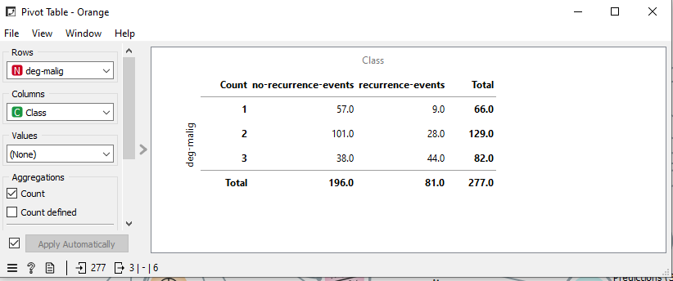
Pivot Table
A PivotTable is a powerful tool to calculate, summarize, and analyze data that lets you see comparisons, patterns, and trends in your data.
With Pivot Table you can count the number of times a feature happen or appear in the data using rows and columns

Slide 25
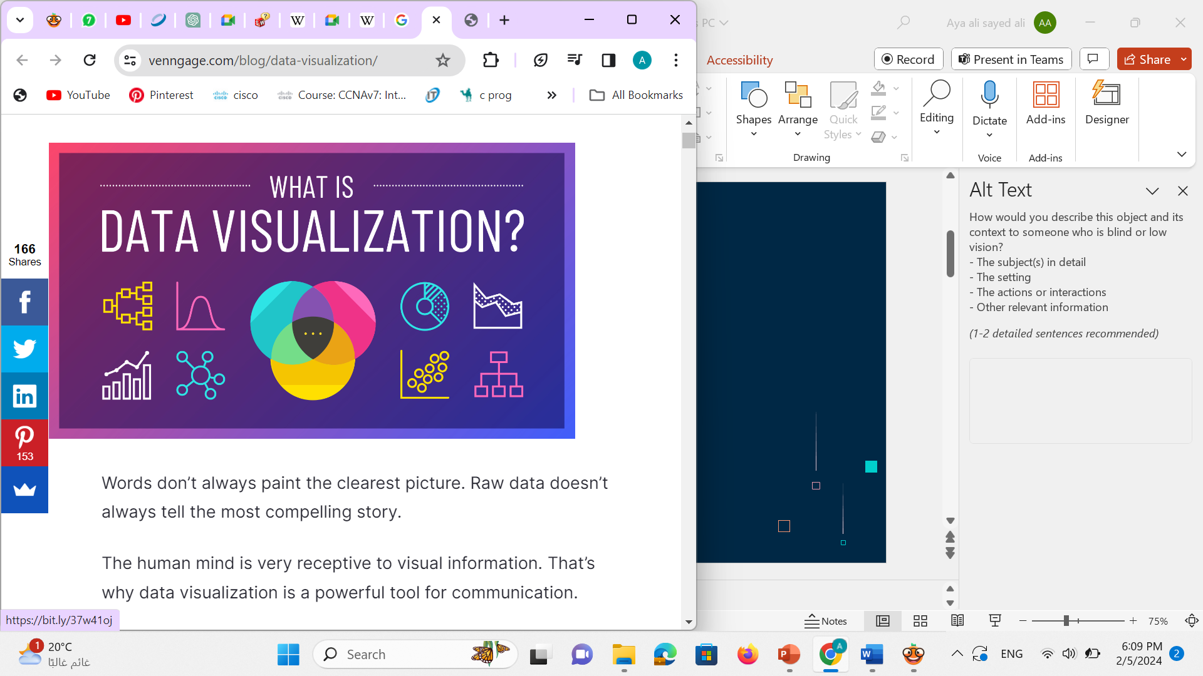
Visualization
Data visualization plays a crucial role in data analysis, decision-making, and communication. It transforms raw data into actionable insights, making information more accessible, understandable, and impactful across a wide range of domains.

Slide 26
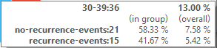
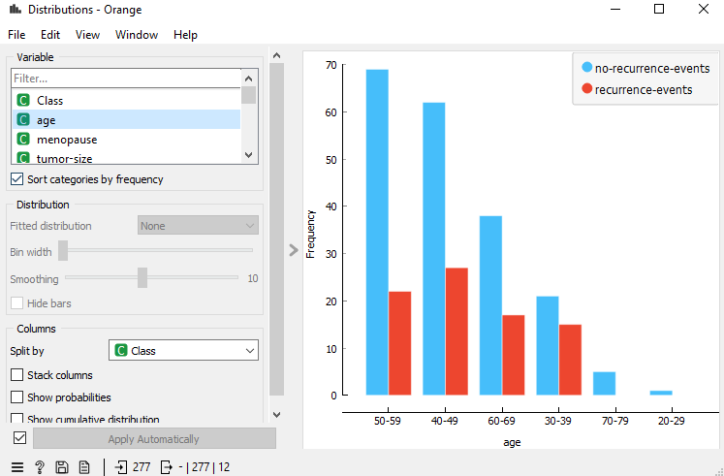
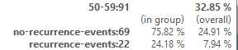
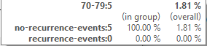
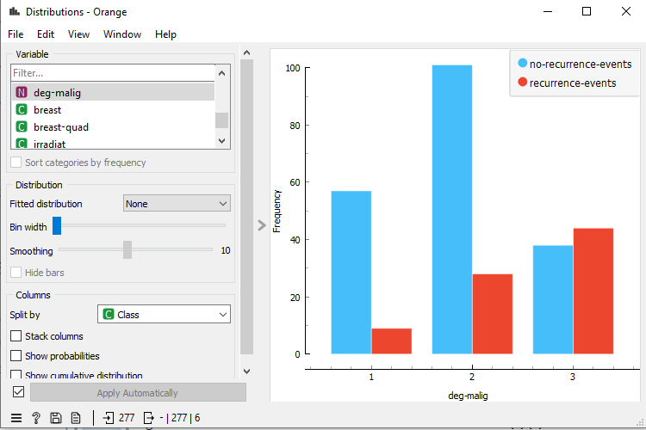
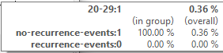
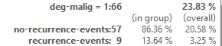
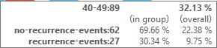
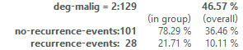
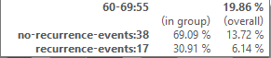
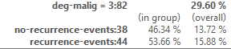
Distributions
Show the number of frequency for every feature in bar graphs

Slide 27
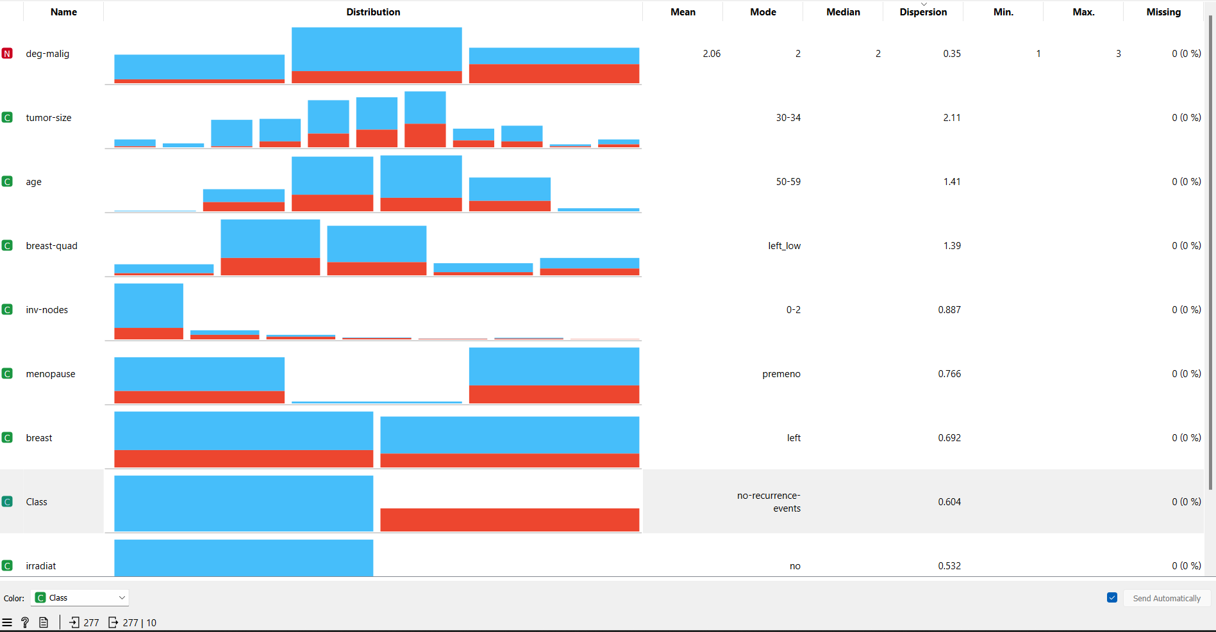
Feature Statistics
The Feature Statistics widget provides a quick way to inspect and find interesting features
in a given data set.
feature statistics are essential for gaining insights into data, detecting patterns, and making informed decisions during the data analysis and modeling processes.

Slide 28
Diagnostic Analytics(Why Happened)
-Identify - RCA root cause Analysis
-Explain “why” things are happening
-Helps to troubleshoot the issue

Slide 29
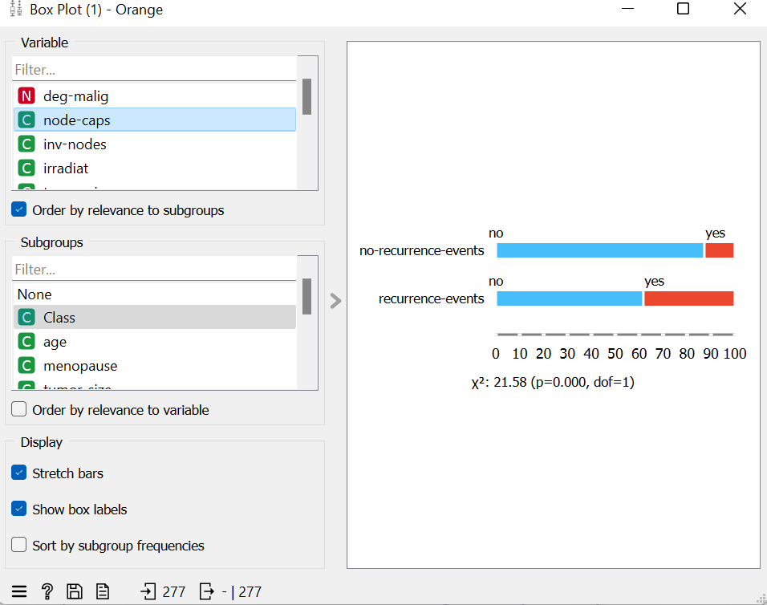
Box Plot
Box plots are commonly used in various situations to visually represent the distribution and key statistical measures of a dataset
Relationship between node-caps and class.
We use the chi-square test to determine the relationship between two categorical variables.
P=0.000 < 0.05 ,then there is a relation between them.

Slide 30
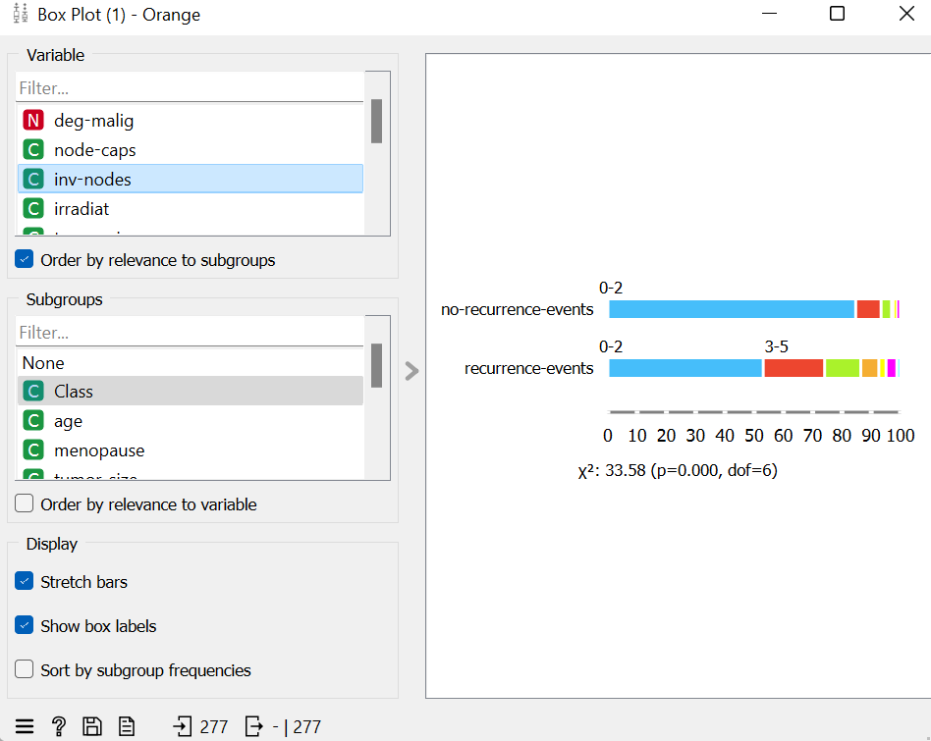
We use the chi-square test to determine the relationship between two categorical variables.
P=0.000 < 0.05 ,then there is a relation between them inv-nodes and class.

Slide 31
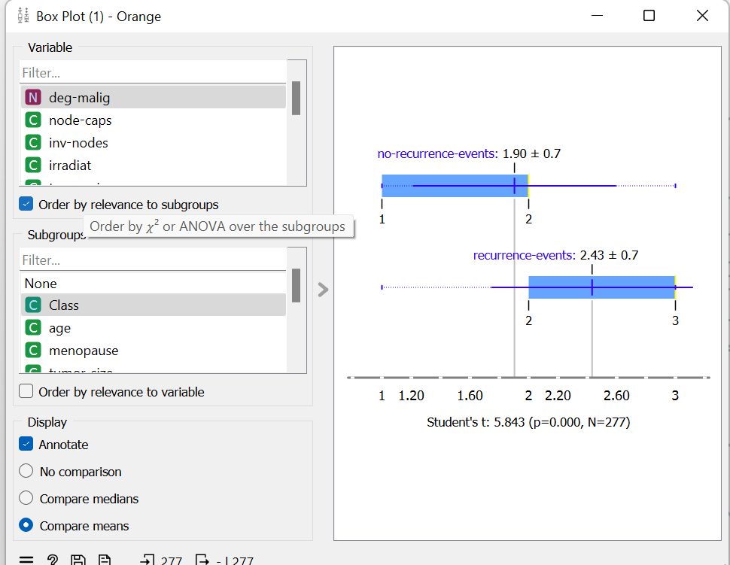
We use The Student's t-test to determine the relationship between two groups(nominal and numerical).
P=0.000 < 0.05 ,then there is a relation between deg-malig and class.

Slide 32
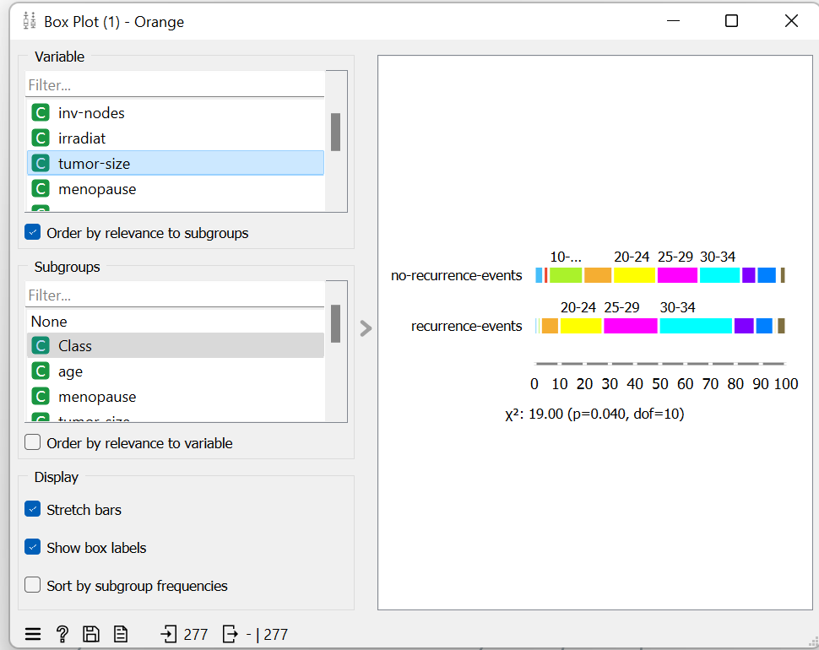
We use the chi-square test to determine the relationship between two categorical variables.
P=0.040 < 0.05 ,then there is a s relation between tumor-size and class.

Slide 33
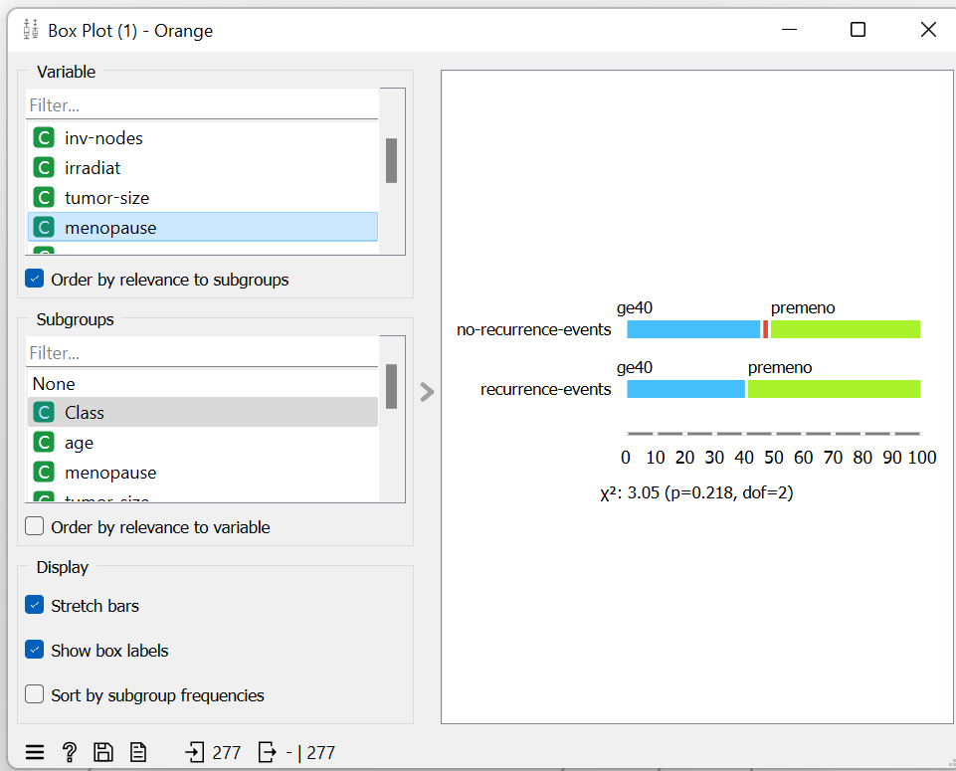
We use the chi-square test to determine the relationship between two categorical variables.
P=0.218 > 0.05 ,then there is no relationship between menopause and class

Slide 34
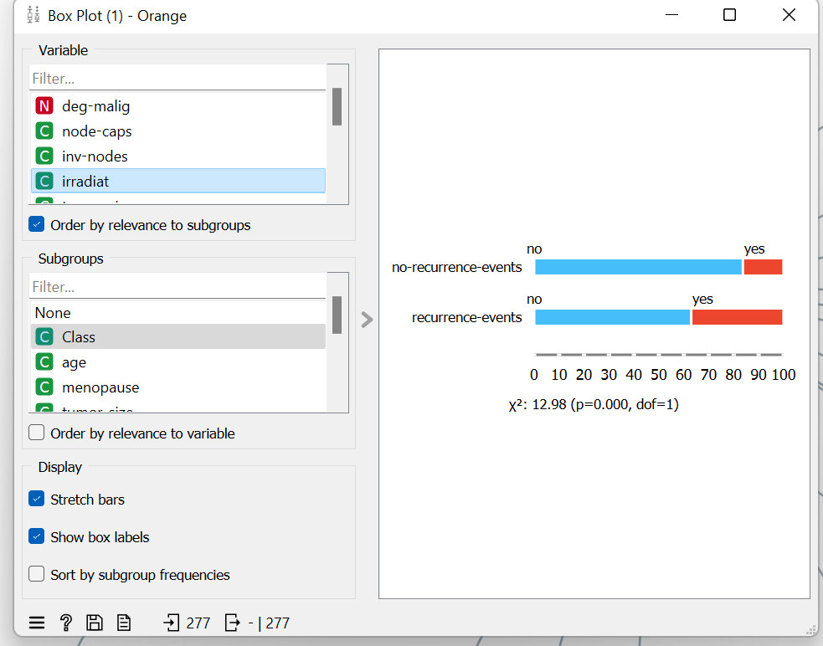
We use the chi-square test to determine the relationship between two categorical variables.
P=0.000 < 0.05 ,then there is a relation between irradiat and class.

Slide 35
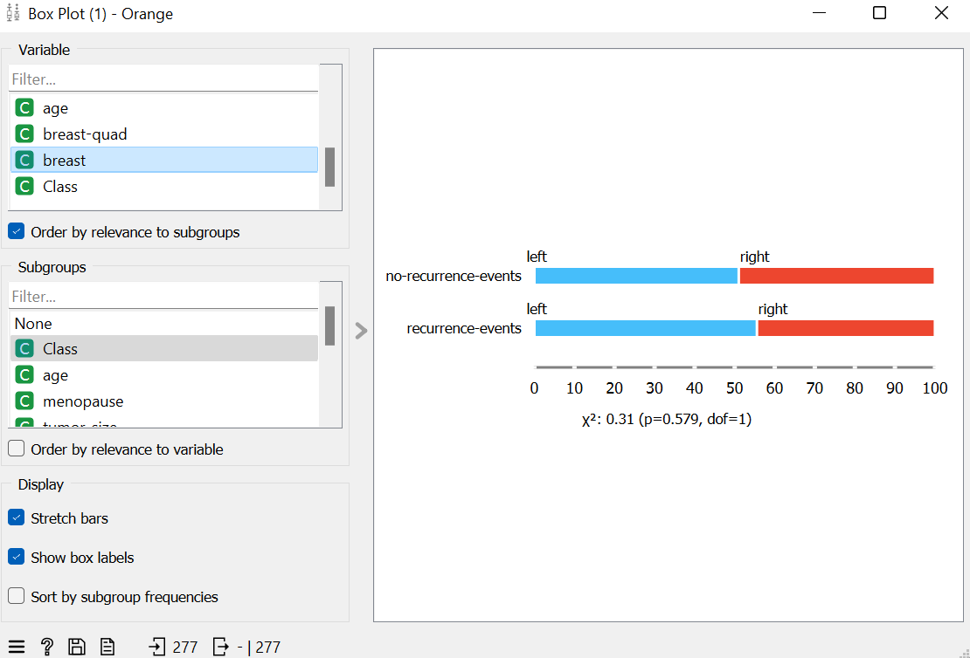
We use the chi-square test to determine the relationship between two categorical variables.
P=0.579 > 0.05 ,then there is no relation between breast and class.

Slide 36
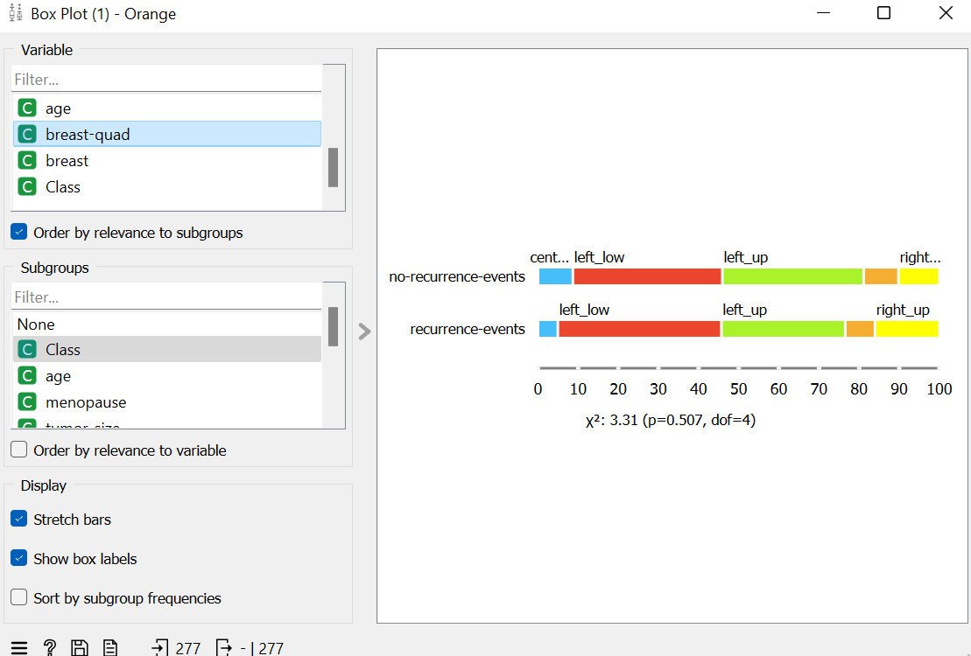
We use the chi-square test to determine the relationship between two categorical variables.
P=0.507 > 0.05 ,then there is no relation between breast-quad and class

Slide 37
Then the order by relevance to class in terms of importance.
deg-malig
node-caps
Inv-nodes
Irradiat
tumor-size
menopause
age
breast-quad
breast

Slide 38
Predictive Analytics
Analytics: It tells what is likely to happen?
Based on historical data and assumes a static business plans models
It is the process of automatically creating a classification model from a set of examples ,called training set , which belongs to set of a set of examples ,called training set , which belongs to set of classes
once the model is created , it can be used to automatically predict the class of other unclassified examples

Slide 39
Modeling (ML)
-Machine learning(ML): is a type of artificial intelligence(AI) that provides computers with the ability to learn without being explicitly programmed.
-Machine learning focuses on the development of computer programs that can teach themselves to grow and change when exposed to new data
Learning Paradigms:
-supervised learning
-Unsupervised learning

Slide 40
Machine Learning
-supervised learning:
. It uses training samples to learn the general relationship between the inputs and outputs
. It has two types which are:
1- Classification 2- Regression
-Unsupervised learning
No desired output is associated with training data.
The core of this project involves the development and evaluation of supervised learning models for predicting breast cancer recurrence. We have explored a variety of machine learning algorithms, including logistic regression, decision trees, random forests, support vector machines and neural network to determine the most suitable approach for this problem.

Slide 41
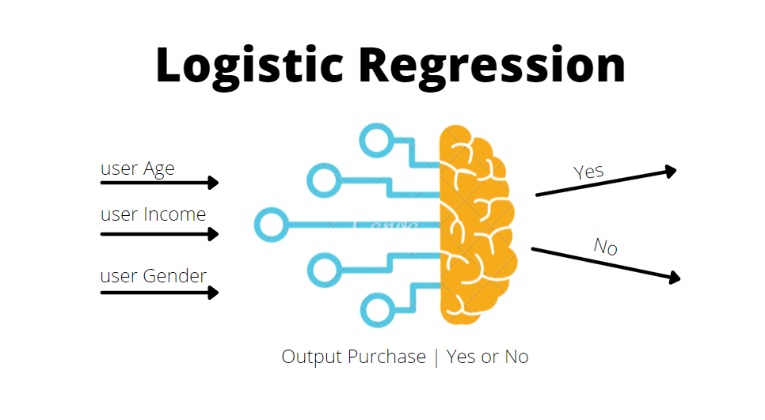
What is logistic regression?
Logistic Model Building
Logistic regression is a supervised machine learning algorithm that accomplishes binary classification tasks by predicting the probability of an outcome (recurrence in this case). The model delivers a binary or dichotomous outcome limited to two possible outcomes: yes/no, 0/1, or true/false
In this case (breast cancer) it can assess the likelihood of recurrence based on patient characteristics
The model analyzes the data to identify relationships between
features and recurrence.
It estimates coefficients that quantify these relationships.
A high probability score from the model indicates a greater chance of recurrence.
Benefits of Logistic Regression
Easy to interpret: Model coefficients provide insights into feature importance.
Relatively fast to train: Makes it suitable for real-time applications in healthcare.
Accuracy: 078

Slide 42
Logistic regression in breast cancer
Breast Cancer Dataset provides information on various patient characteristics along with recurrence labels. Logistic regression analyzes this data to understand how these features influence recurrence. The model assigns weights (coefficients) to each feature, indicating its significance in predicting recurrence. A high probability score generated by the model suggests a higher risk of recurrence. Logistic regression offers advantages like interpretability, making it easier to understand how the model arrives at its predictions. Additionally, it's relatively fast to train, allowing for potential integration into healthcare settings.

Slide 43
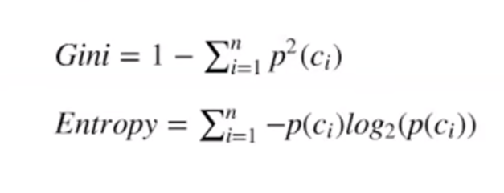
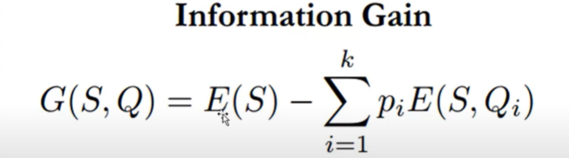
What is decision tree?
A decision tree is a supervised learning algorithm.
Is used for classification and regression modeling. Regression is a method used for predictive modeling, so these trees are used to either classify data or predict what will come next.
Types of decision trees in machine learning
1.Classification trees.
Classification trees determine whether an event happened or didn’t happen. Usually, this involves a “yes” or “no” outcome.
2. Regression trees.
predict continuous values based on previous data or information.
Decision trees look like flowcharts, starting at the root node with a specific question of data, that leads to branches that hold potential answers. The branches then lead to decision (internal) nodes, which ask more questions that lead to more outcomes. This goes on until the data reaches what’s called a terminal (or “leaf”) node and ends.
Gini impurity & Entropy The idea with your (Gini impurity , Entropy) is that we want to make sure that the feature we chose is the most important and best feature I can start my tree with.

Slide 44
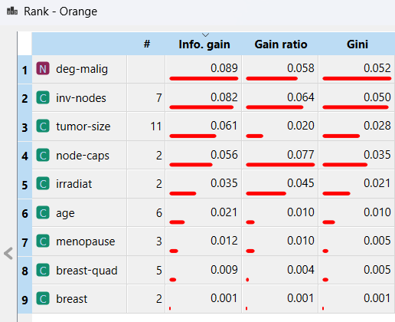
Decision tree Terminology
Root node: The topmost node of a decision tree that represents the entire message or decision.
Decision (or internal) node: A node within a decision tree where the
prior node branches into two or more variables.
Leaf (or terminal) node: The leaf node is also called the external
node or terminal node, which means it has no child—it’s the last node in
the decision tree and furthest from the root node.
Variables: we have two type of variables category or continuous .
Splitting: The process of dividing a node into two or more nodes.
It’s the part at which the decision branches off into variables.
Pruning: The opposite of splitting, the process of going through
and reducing the tree to only the most important nodes or outcomes

Slide 45
Random Forest Model
Random forest, a popular machine learning algorithm that merges the outputs of numerous decision trees to produce a single outcome. Its popularity stems from its user-friendliness and versatility, making it suitable for both classification and regression tasks.
How It Works?
At its core, the Random Forest model operates on the principle of aggregating the results of numerous decision trees. The process begins with bootstrap sampling, where multiple subsets of the training data are created through random sampling with replacement. Each subset is used to train a separate decision tree, with the additional twist that at each node in a tree, a random subset of features is selected for the best possible split. This randomness in both data sampling and feature selection ensures that the trees in the forest are diverse and uncorrelated.

Slide 46
Advantages And Challenges of Random forest Model
Challenges and Considerations
Despite its many advantages, the Random Forest model is not without its challenges. One significant drawback is its complexity. Training and predicting with a Random Forest can be computationally intensive, especially with a large number of trees or when dealing with high-dimensional data. This complexity also translates to reduced interpretability. While decision trees are relatively easy to understand and visualize, a forest composed of hundreds or thousands of trees becomes a "black box," making it difficult to interpret the model's decision-making process.
Advantages of Random Forest
One of the key advantages of the Random Forest model is its high accuracy. By combining the predictions of multiple trees, the model can capture a wide range of patterns in the data, leading to robust performance across various datasets. Additionally, Random Forests are inherently resistant to overfitting, particularly when the number of trees is large. The randomness introduced in the sampling and feature selection processes helps in producing a more generalized model.
In conclusion Random Forest model is a powerful and versatile tool, it is important to consider its disadvantages when choosing it for a particular task. Computational complexity, lack of interpretability, sensitivity to hyperparameters, challenges with imbalanced data, potential overfitting, and data preprocessing needs are significant factors that must be addressed. Understanding and mitigating these drawbacks is essential to effectively leverage the strengths of the Random Forest model in real-world applications.

Slide 47
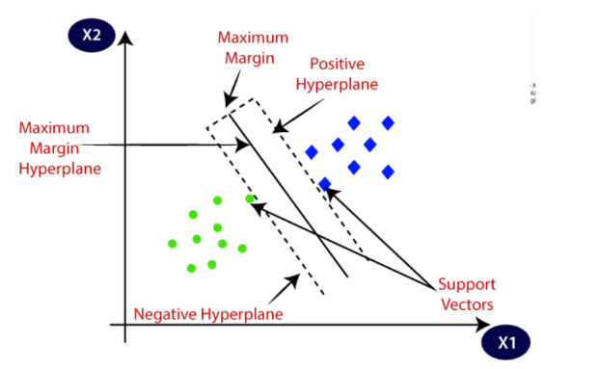
Introduction to SVM:
Support Vector Machine abbreviated as (SVM) is a powerful supervised algorithm that works best on smaller datasets and on complex ones. can be used for both regression, classification and outlier detection purposes tasks, but generally, they work best in classification problems.
Idea an SVM:
The idea of SVM by finding the hyperplane that best separates different classes in the feature space.
How an SVM works:
-SVM works is to have two classes separate them by Generate an optimal hyperplane that separates two classes of data points in the best possible way, .t is known as the maximum margin hyperplane.
- There are many hyperplanes that might classify the data. We should look for the best hyperplane that represents the largest separation, or margin, between the two classes.
Type of SVM :
1- linear
2- non-linear

Slide 48
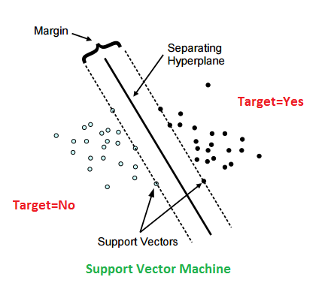
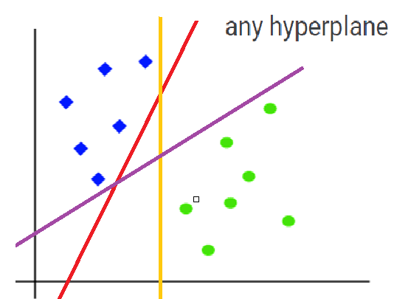
The reason we aim to maximize the margin in SVM is to increase the “robustness” and “generalizability” of the model,
where “Robustness”: A larger margin provides a buffer zone where new data points are less likely to influence the hyperplane position. This makes the model more robust to noise and small changes in the data.
“Generalizability”: A hyperplane that is farther away from the data points (i.e. has a large margin) is less likely to exceed the training data, this solves problems Overfitting occurs when a model fits the training data poorly and performs poorly on unseen data. By maximizing the margin, we ensure that the model generalizes well to new, unseen data, we can solve this problem by using parameter (C)

Slide 49
The margin is the distance between the hyperplane and the closest data points from each category, these closest data points are known as support vectors.
-Support vectors are the sample data points, which are closest to the
hyperplane, called “support” because they support me in being able to distinguish between two classes from each other, meaning they help me in making decisions in the classification process. Through it, I can identify the best Hyperplane that separates two classes from each other.
Implement the Model:
- Cost (C): 5.00
The cost parameter C controls the trade-off between maximizing the margin and minimizing the classification error. while a low C value aims for a larger margin but allows some classification errors (miss-classification), which can help in better generalization.
Regression Loss Epsilon (ε): 0.010 (default value)
The epsilon (ε) parameter in (SVM) provides several benefits, primarily related to how the model handles errors in data and achieves generalization by: Making the model robust to minor fluctuations and noise, helping in better generalization and avoiding overfitting.

Slide 50
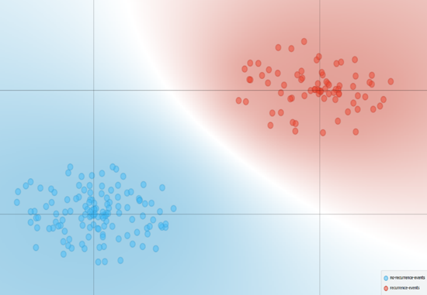
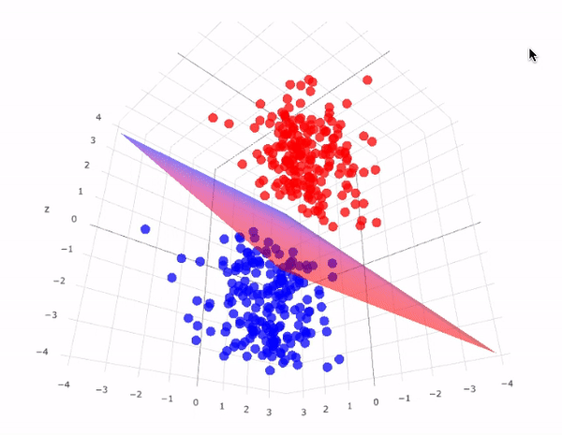

Kernel type (hyperplane) to separates different classes:
Radial Basis Function (RBF) Kernel (Y or gamma) =0.14
Formula: K (x, y) =exp(−γ∥x−y∥^2), where: K (x, y) is the kernel function measures the similarity between two data points x and y.
x and y are two input vectors, Gamma (γ or g): The parameter γ controls the width of the Gaussian kernel, ∥x−y∥^2 is the squared Euclidean distance between x and y, exp denotes the exponential function.
The exponential function is applied to the negative squared distance multiplied by γ.
The kernel function essentially measures the similarity between x and y. The similarity is higher when x and y are closer, and it decreases exponentially as the distance increases.
γ controls the width of the Gaussian function, affecting how quickly the similarity decreases with distance The exponential function ensures that the kernel values are between 0 and 1, with higher values indicating greater similarity, give
Accuracy: 0.946

Slide 51
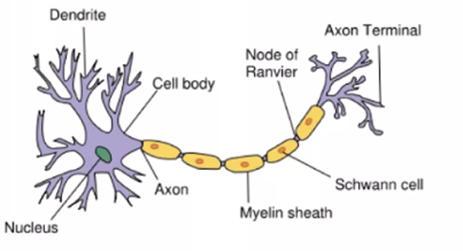
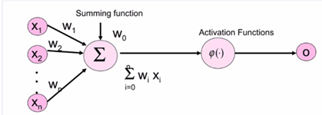
Artificial Neural Network
Model Architecture
Artificial Neural Network are inspired by the learning processes that take place in biological systems. A computational model that simulate some properties of human brain.
The connections weight and nature of units determine the behavior of neural network.
Used in developing artificial detection of reoccurrence of breast cancer event or not
Neural networks are a powerful machine learning technique inspired by the human brain. They consist of interconnected nodes, or neurons, that process and learn from data to make predictions or decisions.
Layers :the model consists of multiple hidden layers that learn complex representations of the input data
Activation Functions : Nonlinear activation functions, like tanh are applied to the layer outputs to introduce nonlinearity. We use tanh
Trainable Weights : The model parameters, including the weights and biases, are learned through the training process.
Optimization : The model is trained using techniques like backpropagation and gradient descent to minimize the loss function.

Slide 52
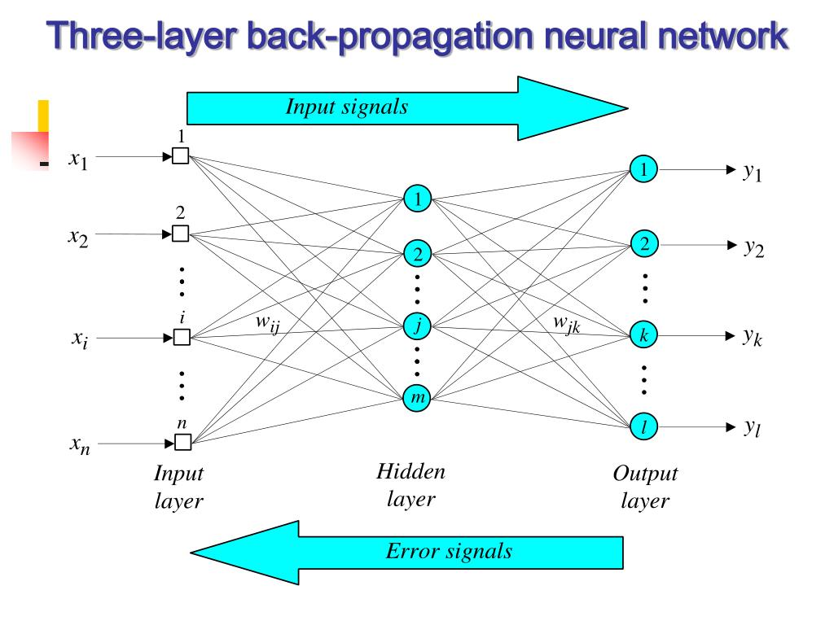
Backpropagation
MLP Classifier
A common method for training a neural network.\
Backpropagation is an approximate steepest descent algorithm, in which the performance index is mean square error.
Initial system output is compared to the desired output, and the system is adjusted until the difference between the two is minimized.
The goal of backpropagation is to optimize weights so that the neural network can learn how to correctly map arbitrary inputs to outputs.
The multilayer perceptron, trained by the backpropagation algorithm, is currently the most widely used neural network and can solve non-linear separable problems .
MLPs are commonly used for supervised learning tasks, such as classification, where the goal is to map input data to output labels.
The MLP architecture can be tailored to a wide range of problems by adjusting the number of layers, neurons, and connections between them.
Accuracy : 0.957

Slide 53
Model Evaluation and Performance Metrics
To ensure the reliability and generalizability of the developed models, we have implemented a rigorous evaluation process. This includes the use of cross-validation techniques, such as k-fold cross-validation, to assess the models' performance on unseen data and prevent overfitting
Key performance metrics, such as accuracy, precision, recall, F1-score, and area under the receiver operating characteristic (ROC) curve, are used to measure the models' ability to accurately predict breast cancer recurrence. These metrics provide a comprehensive understanding of the models' strengths, weaknesses, and overall effectiveness in supporting clinical decision-making.
Confusion Matrix:
The starting point for calculating performance metrics.
1
Accuracy:
Calculated as (TP + TN) / (TP + FP + TN + FN).
2
Precision:
Calculated as TP / (TP + FP).
3
Recall:
Calculated as TP / (TP + FN).
4
F1-Score:
2 * (Precision * Recall) / (Precision + Recall).
5

Slide 54
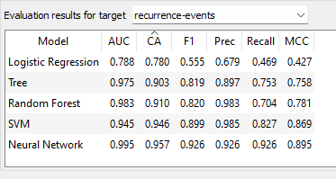
Results and Discussion
-The findings of this project demonstrate the potential of data mining and machine learning in enhancing breast cancer recurrence prediction. The developed models have shown promising performance, with the neural classifier achieving the highest accuracy and area under the ROC curve. These results highlight the value of leveraging ensemble techniques to capture the complex relationships within the data and make more robust predictions.
-The analysis also revealed the most influential factors contributing to breast cancer recurrence, such as tumor size, lymph node involvement, and specific treatment modalities. These insights can inform clinical decision-making and guide the development of personalized treatment strategies for patients.

Slide 55
Model Deployment
Model deployment : is the process of integrating a trained machine learning model into a production environment where it can be used to make predictions on new, unseen data. Here is a detailed guide on deploying a model for predicting breast cancer recurrence based on features like degree of malignancy (deg malig), tumor size, involved lymph nodes (any nodes), and age.
simply means integrating a machine learning model into an existing production environment where it can take in an input and return an output. The purpose of deploying your model is so that you can make the predictions from a trained machine learning model available to others, whether that be users, management or other systems.
Model deployment is closely related to machine learning systems architecture, which refers to the arrangement and interactions of software components within a system to achieve a predefined goal.
Model Deployment must be achieve Portability and Scalability.

Slide 56
Introduction to Orange Tool
Orange is a powerful open-source data visualization and analysis tool, particularly popular for its user-friendly interface and capabilities in machine learning and data mining.
Orange allows you to: – Show a data table and select features – Read the data – Compare learning algorithms and train predictors – Visualize data elements

Slide 57
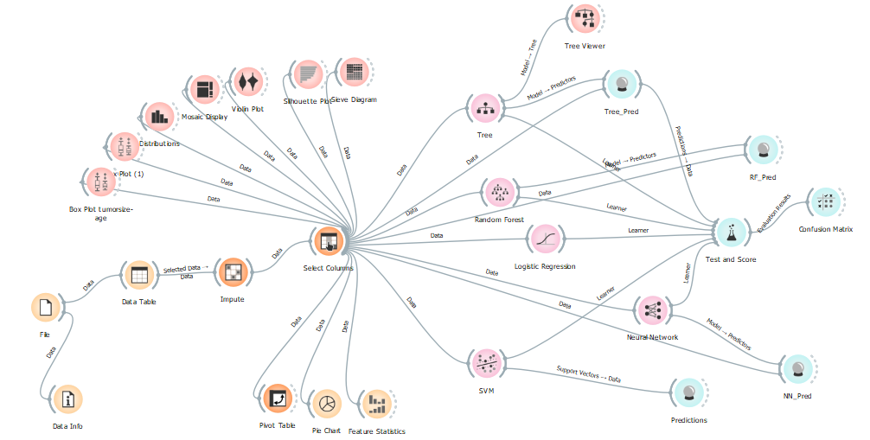
How to use workflows in Orange?
We have created a simple workflow wherein the inbuilt breast cancer dataset . The workflow is such that data from the dataset is sent to the data table, to Distributions for creating a distribution and a Scatter Plot is plotted from the dataset. To create this workflow we load the dataset using the File widget, and then flow between File-Data Info,……….

Slide 58
Conclusion and future Work
05

Slide 59
Perspective Analytics
Prescriptive analytics is the process of using data to determine an optimal course of action. By considering all relevant factors, this type of analysis yields recommendations for next steps. Because of this, prescriptive analytics is a valuable tool for data-driven decision-making.
By prescriptive analytics we can to answer the questions to prevent something or Reduce that something is happening or to improve something.

Slide 60
Conclusion and Future Work
In conclusion, this project has demonstrated the potential of data mining and machine learning in enhancing breast cancer recurrence detection and management. The developed predictive models have shown promising results in accurately identifying patients at high risk of recurrence, paving the way for more personalized and proactive cancer care.
Moving forward, we aim to further refine and expand the scope of this work by incorporating additional data sources, such as genomic and imaging data, to improve the models' predictive performance. Additionally, we plan to explore the deployment of these models in clinical settings, providing healthcare professionals with a decision support tool to optimize treatment plans and improve patient outcomes.

Slide 61
Tools Prototype
06

Slide 62






Tools and Languages

Slide 63
References
07

Slide 64
References:
https://iopscience.iop.org/article/10.1088/1757-899X/1022/1/012071/pdf
Breast Cancer Dataset (kaggle.com)
http://www.ijarse.com/images/fullpdf/1515142902_SEC_1017ijarse.pdf
Orange Visual Programming — Orange Visual Programming 3 documentation (orange3.readthedocs.io)

Slide 65
Thanks

